Slide 1
Genome Genetic Counseling

Slide 2

Genome Medical Overview

Slide 3








Genome Medical Process
Genetic testing
requested/recommended
Referral emailed/faxed
to Genome
GM staff calls
patient to schedule
Pre-Test Consult
Test collected
& resulted
Post-Test Consult
HIM uploads
summary to Epic
Inbasket message
sent to provider

Slide 4
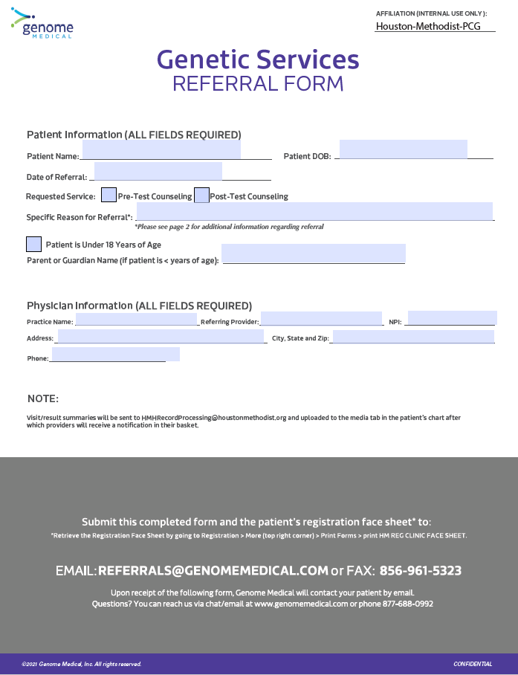


Genome Medical Process
Genetic testing
requested/recommended
Referral & Facesheet emailed/faxed
to Genome
GM staff calls
patient to schedule
Pre-Test Consult
Test collected
& resulted
Post-Test Consult
Summary sent
to provider
Staff uploads
to Epic

Slide 5
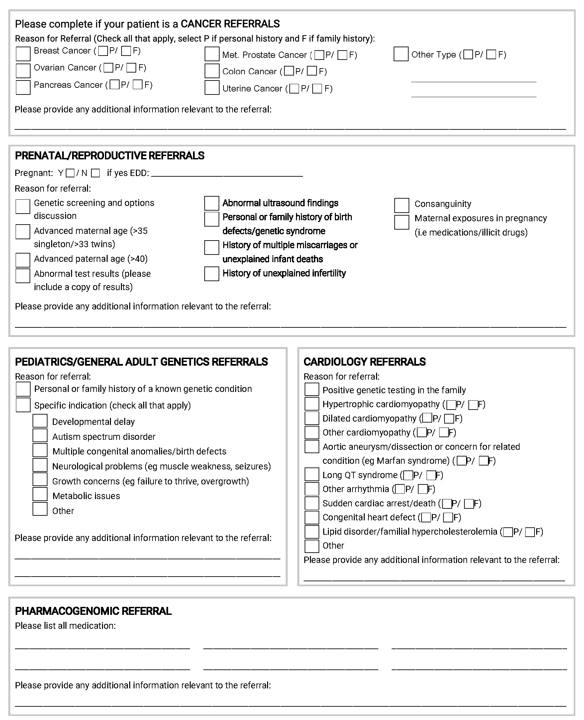
Referral Options

Slide 6
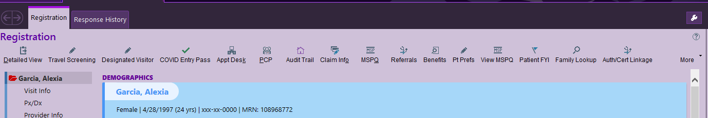
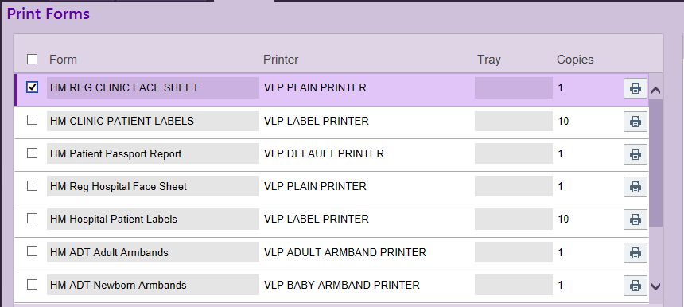
Add Facesheet
1.From the registration page select “More”
2. Select “Print Forms”, Select “HM REG CLINIC FACE SHEET” select the “Printer Icon”

Slide 7
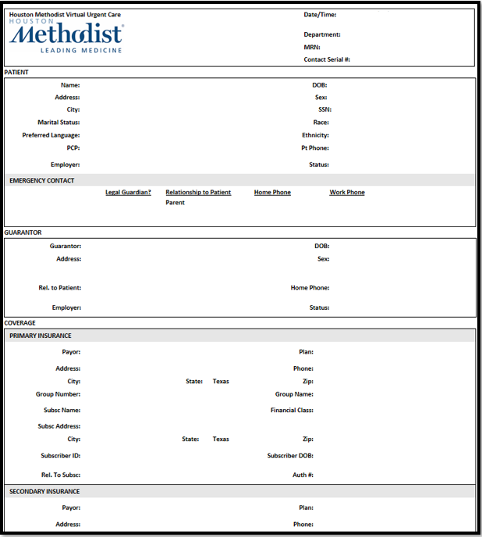
Referral and Facesheet
Email: Referrals@GenomeMedical.com
Fax: 856-961-5323

Slide 8
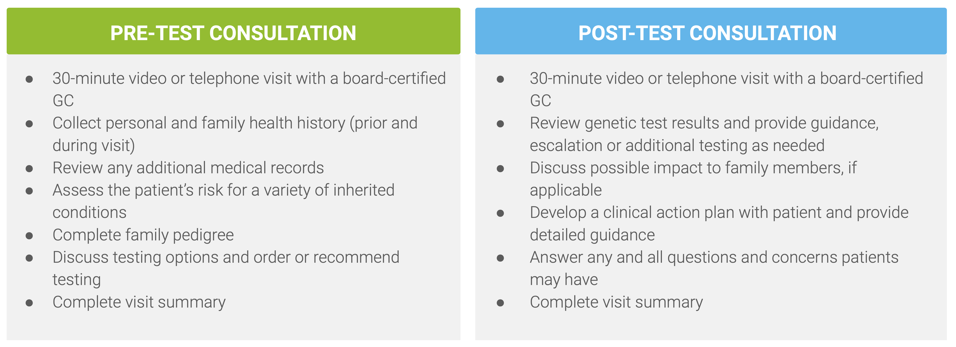
Genome Medical Process
Genetic testing
requested/recommended
Referral emailed/faxed
to Genome
GM staff calls
patient to schedule
Pre-Test Consult
Test collected
& resulted
Post-Test Consult
Summary sent
to provider
Staff message
Send to provider

Slide 9
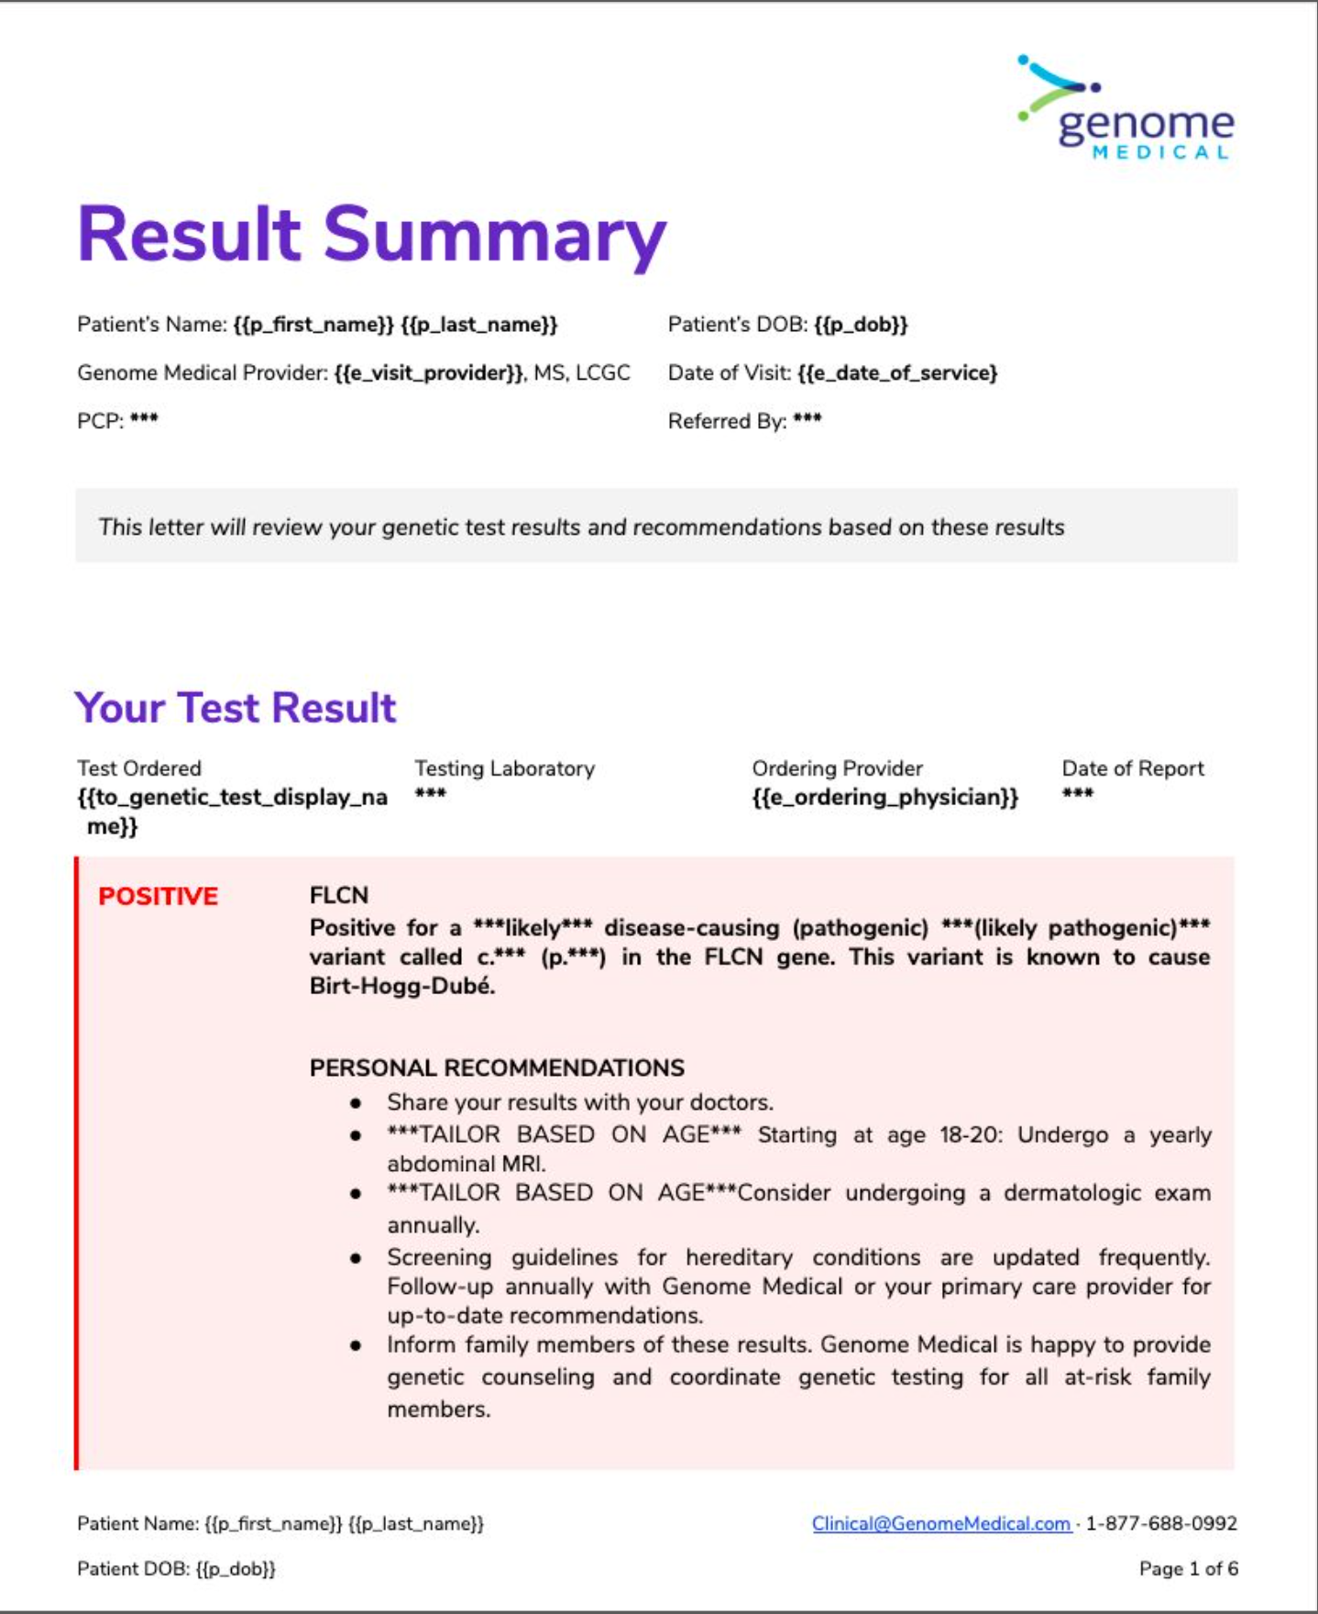
Genome Medical Process
Genetic testing
requested/recommended
Referral emailed/faxed
to Genome
GM staff calls
patient to schedule
Pre-Test Consult
Test collected
& resulted
Post-Test Consult
HIM uploads
summary to Epic
Inbasket message
sent to provider

Slide 10
FAQs
How soon are appts made?
  On average, within 48 hours
How much does a genetic counseling consult cost?
  Genome Medical is a licensed medical practice and is credentialed and contracted with many of the major insurance companies. Genome Medical will work with your patient to confirm and verify coverage for services. Medicaid and Medicare are not accepted. Self-pay rate: $129
How much does genetic testing cost?
  Genome will work with patients and their insurance to determine the preferred test & lab. Some tests are sponsored and are provided at no cost to the patient
What is required of my staff?
  Email/fax the referral form
What is required of me when I receive the results back?
  Review and sign off

