Slide 1
IT CONTRACT MANAGEMENT PROCESS
(ONBASE)
October 5, 2020

Slide 2

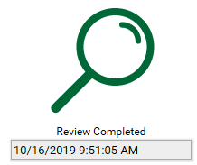
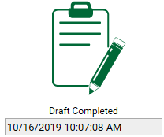
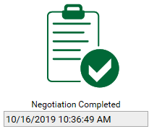
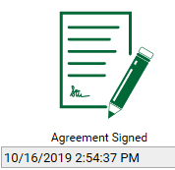
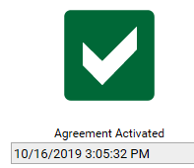
High Level Process
IT Director: Follow steps 1 – 4
2
Review Important Reminders
Pre-OnBase Tasks
1
3
Choose Workflow
Upload Required Attachments
4
5
6
7
8
9
Note: click on hyperlinks for more detail on process steps

Slide 3
Detailed Process
1
Pre-OnBase Tasks
IT Director:
Receives request, evaluates for duplicate products/services.
Obtains Council Approval.
Reviews business terms, warranties, pricing, etc.
Security assessment.
SAR survey/Technical assessment.
Vizient review: $ and verbiage.
If access to PHI, send DPA and BAA for vendor review.
IT Director:
Completes request form.
Choose approval workflow.
Uploads required documents – see notes section below.
Contract Admin:
Confirms required documents are attached.
Reviews verbiage.
Verifies agreement conforms to Master, if needed.
Contract Admin:
Routes agreement for internal IT, Legal and Risk review.
Contract Admin:
Routes for vendor edits via ShareBase.
Sends vendor edits for IT, Risk or Legal review, as needed.
Contract Admin:
Routes for signatures/legal stamp once terms are agreed upon.
Activates contract once signed and stamped.
IT Director
Security
IT VP
Infra.
Risk
Legal
Vendor
2
3
4
5
6
7
8
9
Back to High Level Process

Slide 4

Important Reminders
Important Reminders
Remember:
All documents to be reviewed/approved must be submitted in Word and unprotected for editing (.pdf format not permitted).
Any legally binding document requiring signature needs review/approval. Don’t assume an agreement doesn’t need review.
Submit your agreements as far in advance as possible.
Do not send or take your agreements directly to a VP or CIO for signature.
Agreements must be submitted via OnBase for review and approval.
To request escalation of your agreements please contact your VP; do not contact Legal for escalations or status.
Note: These are guidelines and can be updated at any time.
Back to High Level Process

Slide 5
Choosing the
Correct Workflow
3
Choose “Master Workflow” for: | Choose “Other Workflow” for:
Master Agreements | Orders
Software License Agreements | Proposals
Professional Services Agreements | Work Orders
End User Agreements | Quotes
Evaluation Agreements | Amendments
Data Processing Agreements (DPA) – new DPA for existing vendor can be submitted through “Other Workflow” | Addendums
Business Associate Agreements (BAA) – new BAA for existing vendor can be submitted through “Other Workflow” | Any other documents that need signature
End User Agreements
Evaluation Agreements
SaaS
Tips:
Choose Area based on contract’s impact area.
Reviewing Department field – always choose ‘Information Technology’.
Back to High Level Process

Slide 6
Required Attachments
4
New vendor:
Business Case (supporting document).
Agreement and other documents to be reviewed/approved.
All documents required to set up new vendor in MARS (see Vendor Setup Forms).
Certificate of Insurance (COI) - request from vendor.
Service Organization Control Report (SOC2) if accessing PHI - request from vendor.
Existing vendor (master agreement already in place):
Document(s) to be reviewed/approved.
Note: All documents to be reviewed/approved must be submitted in Word and unprotected for editing (.pdf format not permitted).
Back to High Level Process

