Slide 1
WebEx − Using It with Mobile Devices

Slide 2


Objectives
By the end of this eLearning, here’s what you’ll be able to do on your mobile device:
Set up WebEx.
Schedule a WebEx meeting.
Join a WebEx meeting.
Share your content.
Find additional resources.

Slide 3
About WebEx
What’s WebEx?
Allows you to schedule or attend online meetings.
Available on all your devices (for smartphones, download the WebEx app).
Share your screen with others, so they can see a presentation or other documents.

Slide 4
Set Up WebEx for Your Mobile Device

Slide 5
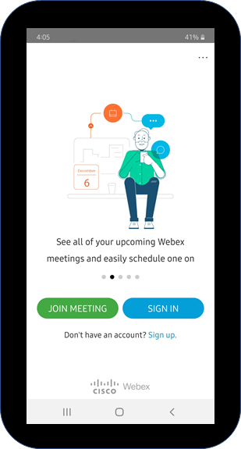
Set Up WebEx for Your Mobile Device
Install WebEx
Go to your device’s app store.
Download the Cisco WebEx Meetings app and install.

Slide 6
Join a WebEx from Your Mobile Device

Slide 7
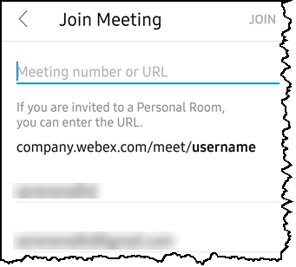
Join a WebEx Meeting
Join a meeting without logging in
Tap Join Meeting
Use the information you received in Outlook.

Slide 8
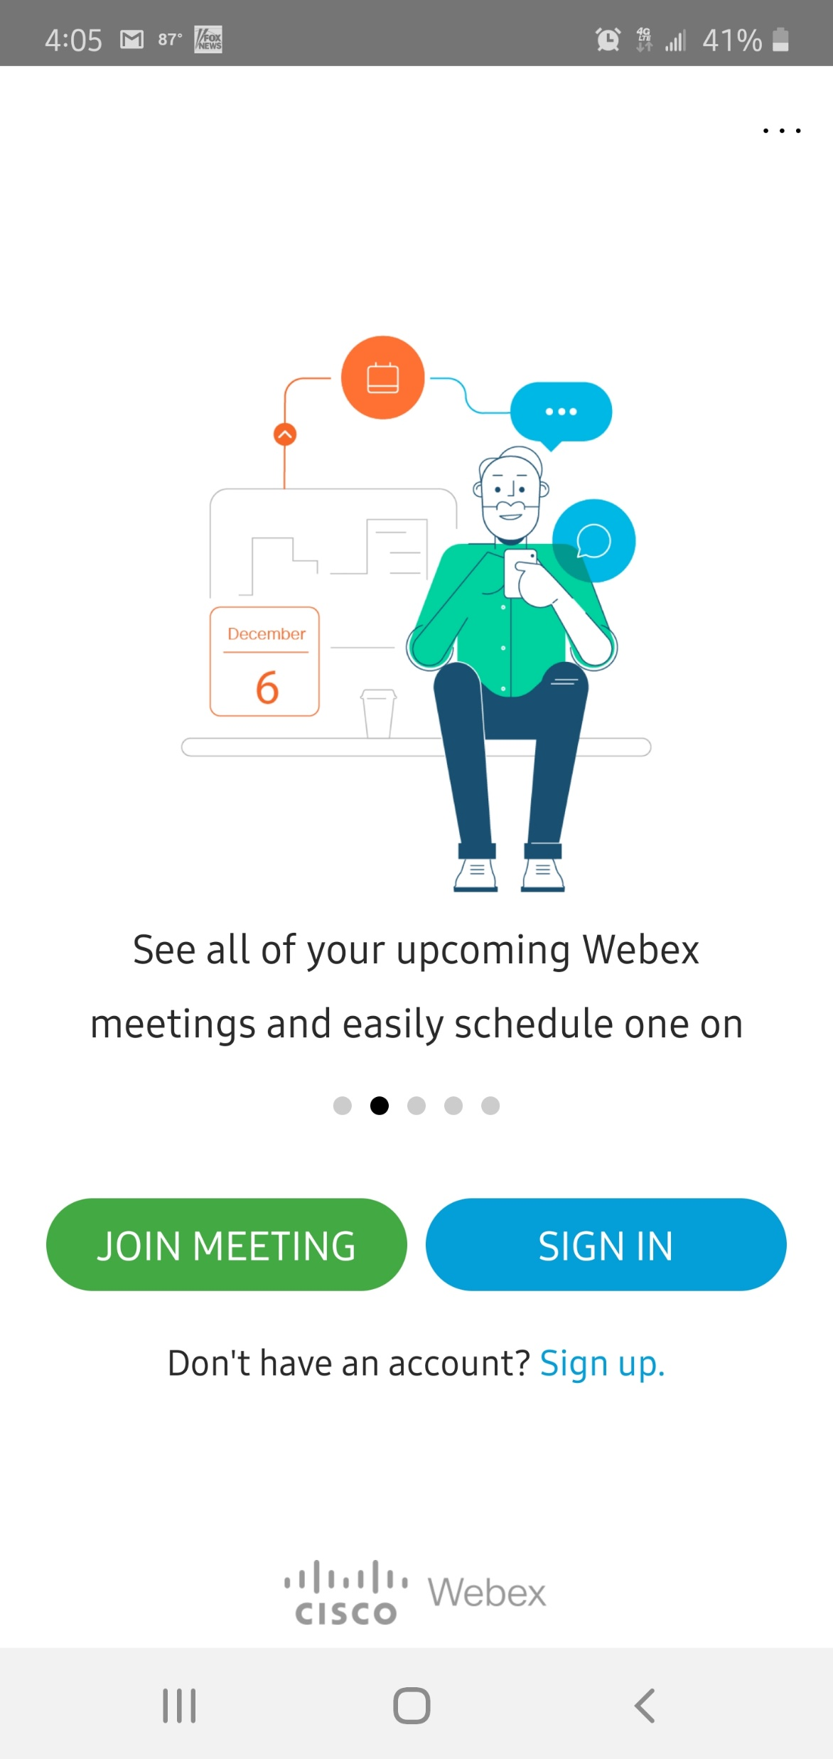
Log in WebEx for Houston Methodist
Log in for more functionality
Tap Sign In.

Slide 9
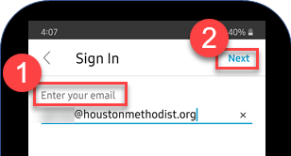
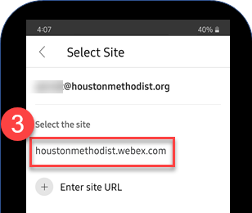
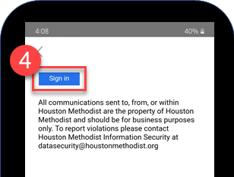
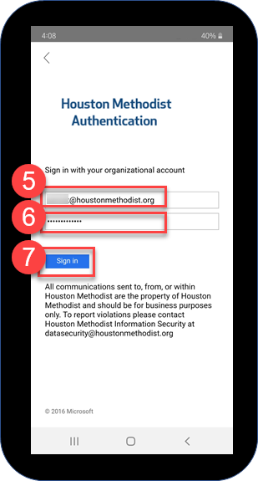
How to Log in WebEx
Enter your Houston Methodist email address.
Tap Next.
Tap houstonmethodist.webex.com.
Tap Sign In.
On the HM authentication screen, enter your HM email address.
Enter your HM password.
Tap Sign In.

Slide 10
Start a WebEx Meeting

Slide 11
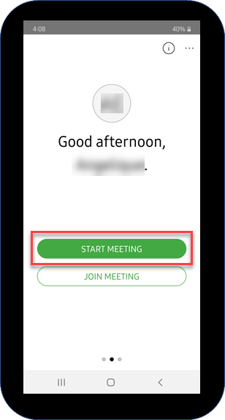
Start a WebEx Meeting – Personal Room
Start a meeting using what’s called your Personal Room
Tap Start Meeting.
Your Personal Room is your WebEx “conference room” where you can have ad hoc meetings. It even includes a unique hyperlink.

Slide 12
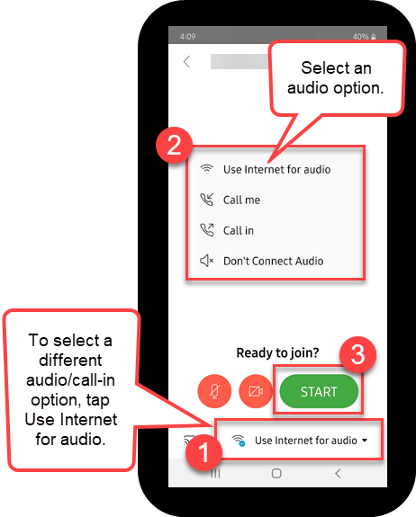
Connect to a WebEx Meeting
Easiest audio method
Tap “Call me.”
Tap Start.

Slide 13
WebEx Meeting Functionality and Options

Slide 14
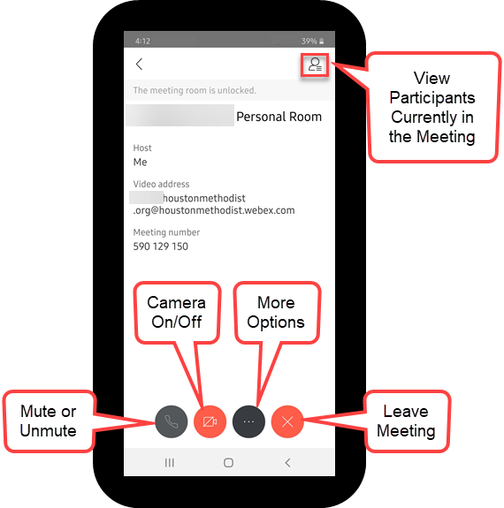
WebEx Functionality – Personal Room
From your Personal Room
See who’s attending meeting, invite others, chat with participants.
Mute or unmute yourself and others.
Turn camera on or off.
See more options.
Leave the meeting.

Slide 15
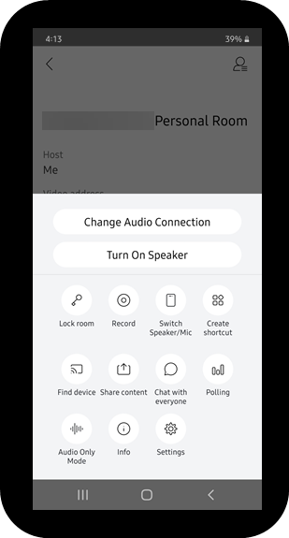

WebEx Options – Personal Room
Tap to select options like these
Turn your speaker on or off.
Record the meeting, if you’re the host.
Share your content.

Slide 16
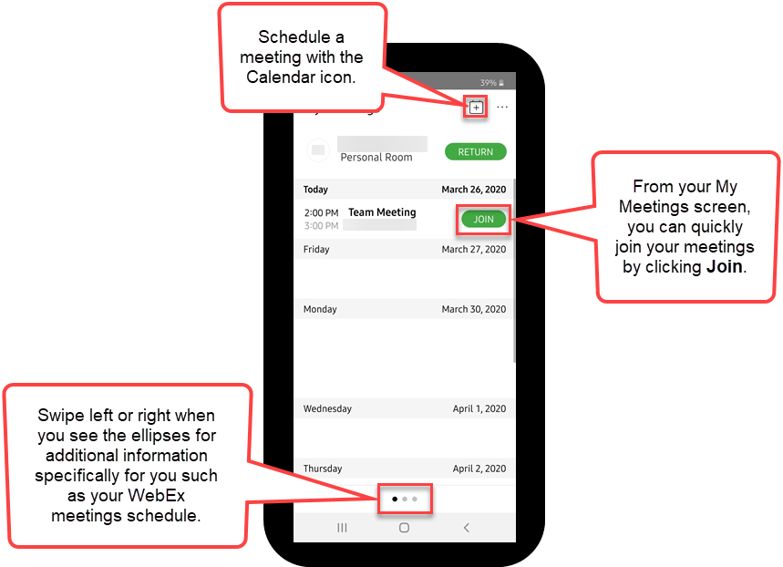
Additional Icons and Meanings
Find more WebEx information
Tap the ellipses (bottom of screen) when viewing specific information.
Swipe left or right to see different screens.
Example: My Meetings screen. From here you can:
  View meetings, today’s and upcoming.
  Schedule or join a
  meeting.

Slide 17
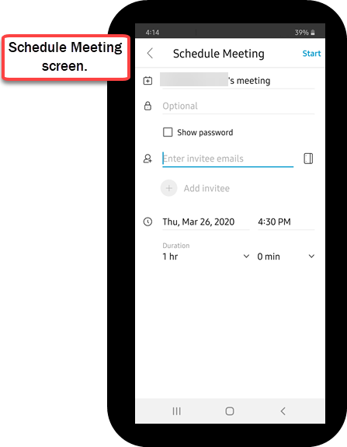
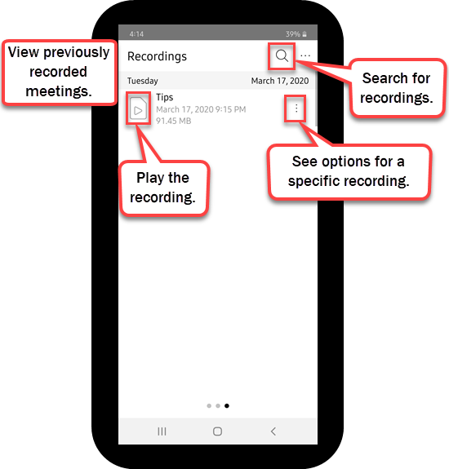
Additional Icons and Meanings

Slide 18
Additional WebEx Resources

Slide 19

WebEx Resources
For more WebEx information, visit it.houstonmethodist.org/remote, then click WebEx.
This website also includes other tools and tips for working remotely.

